Slide 1
Blue Green Deployment Model
For Peace Haven Federal
DevOps Clients

Slide 2
Problem Statement-
One of the challenges with automating deployment is the cut-over itself, taking software from the final stage of testing to live production. You usually need to do this quickly in order to minimize downtime.
Proposed Solution -
The blue-green deployment approach does this by ensuring you have two production environments, as identical as possible.
This technique is something that is very popular in the industry having zero downtime and having the software as productive as it can be.

Slide 3
Description of Blue-Green Deployment
Blue-Green deployment is a technique that reduces downtime and risk by running two identical production environments called Blue and Green.
Blue Environment is the Live Environment with the existing code serving census.gov
Green Environment is the standby environment where the new code is released and tested
On the Day of the Deployment – The Router is pointed towards the Green Environment.

Slide 4
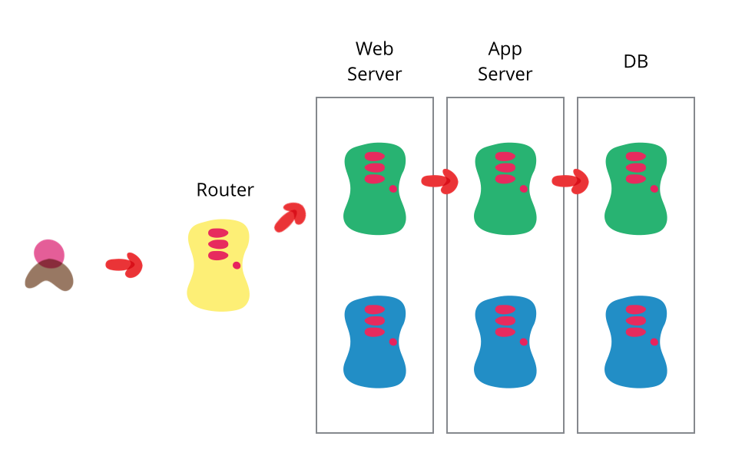

Slide 5
So what are the benefits of Blue Green Deployment Model
Proven in the industry
Your software is as useful as it can be
Quick Rollback if you decide to change to the Previous Release
Sufficient time for the Client to test the New Releases
So the Federal customers we helped with this Blue Green Deployment Model
The Blue Green Deployment Solution was Implemented by our DevOps Consultants at USPTO and Department of Commerce, providing a redundant framework for the end clients and also have one hour production Deployments
The Federal Customers were impressed with the Service due to the following benefits
- Developers had a Environment that mimics the exact Production Envt
Testers had enough time to test the Application in a production setup
All the Statkeholders didn’t have to give up weekends to roll into production

